Slide 1
Insignificance
A game with no meaning whatsoever

Slide 2
Why?
Play as a brain of the most brainless
adventurer ever to be put in a game developed by myself.
Included-
Colorful console text!
Making bracelets!

Slide 3
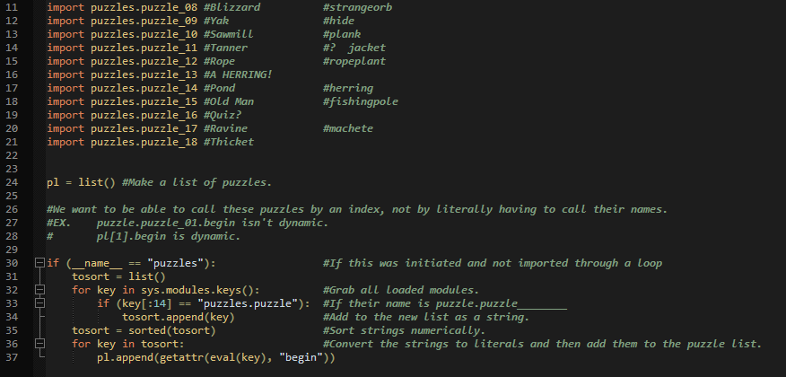
(Not quite)
Stupendously programmed!
Calling functions by their actual names is long and not dynamic. Put them in a list instead!
Doing this we can -
Place each puzzle into their own file
Numerically sort the functions
Call the functions from a list, using an index!

Slide 4
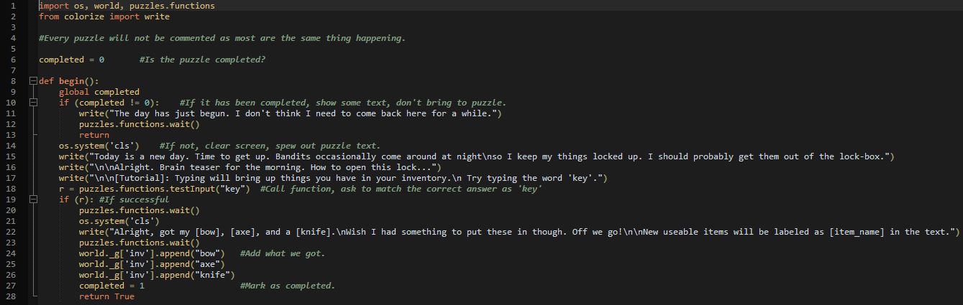
Unclutter Messes!
By breaking up the code into separate files, you can easily debug code and narrow down your searches!

Slide 5
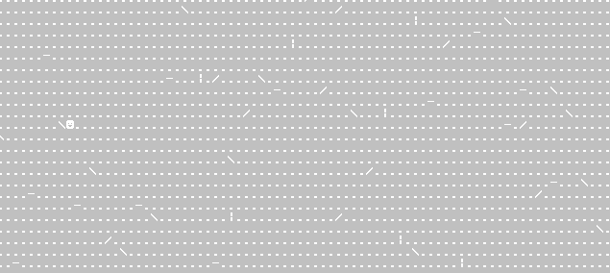
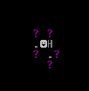
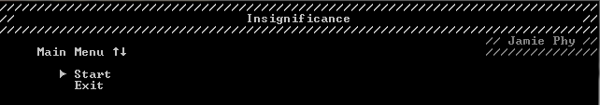
Enjoy the game!
Animated cutscene!
Least of all, you can actually play the game to have minor enjoyment!
Wow!
Main menu!
Woah!
Explorable Map!

